Slide 1

NYC East River Bicycle Crossings traffic predictions
Anna Kalinowska
a.e.kalinowska@gmail.com

Slide 2
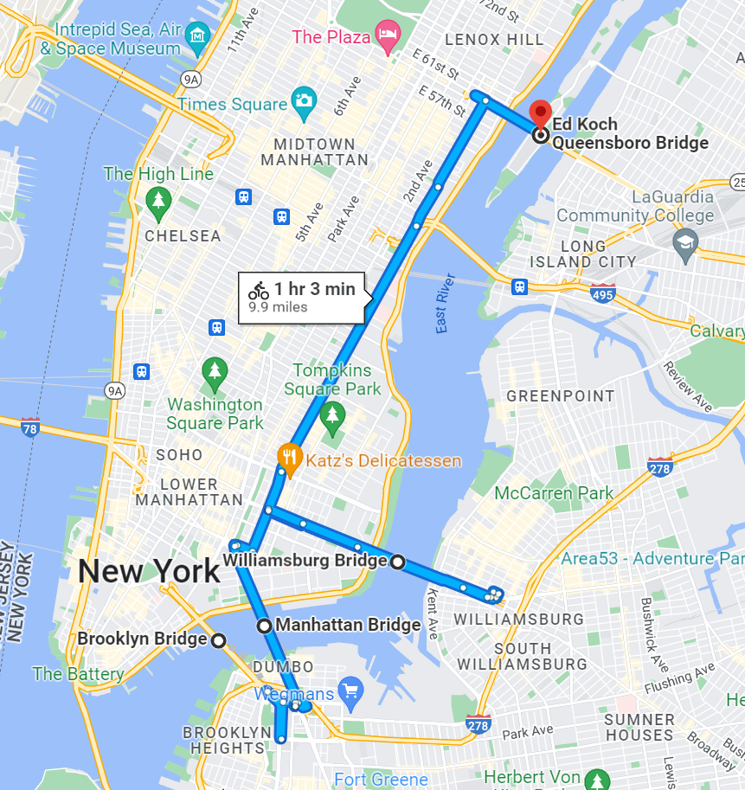
NYC East River Bicycle Crossings what are they?
Ed Koch Queensboro Bridge
Williamsburg Bridge
Manhattan Bridge
Brooklyn Bridge

Slide 3

NYC East River Bicycle Crossings what do we want to learn?
How many bicycles cross into and out of Manhattan per day?
What is the top bridge in terms of bike load?
Which factors allow to predict daily total bike traffic volume on East River Bicycle Crossings?

Slide 4

NYC East River Bicycle Crossings what is our analytical approach?
Analyze daily traffic volumes per Crossing (April 2017-October 2017)
Discover underlying patters and relationships between gathered data
Apply supervised ML algorithms to predic the daily, total traffic volume on all NYC East River Bicycle Crossings

Slide 5
NYC East River Bicycle Crossings
how many bicycles cross into and out of Manhattan per day?
Over 16 K bikes – on avarage -crossed Manhattan on daily basis
Williamsburg Bridge is the busiest crossing accounting for 36% of the traffic
Date range: April 2017 – October 2017

Slide 6
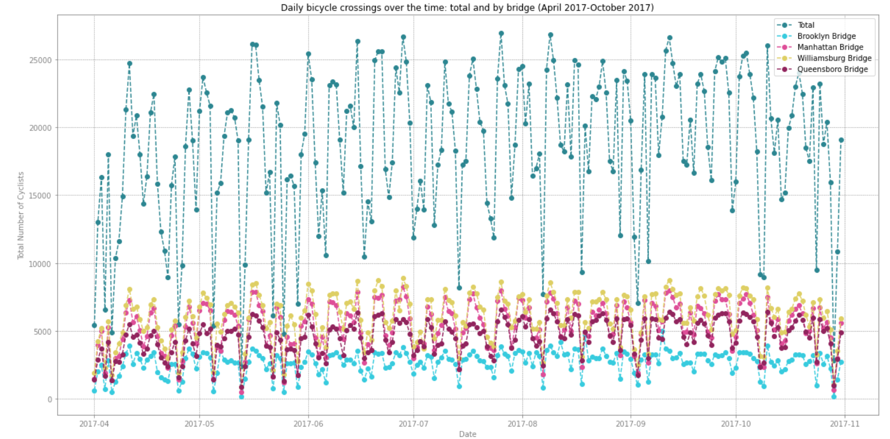
NYC East River Bicycle Crossings
bicycle traffic characterises with distinctive weekly patterns stable over the time
Date range: April 2017 – October 2017

Slide 7
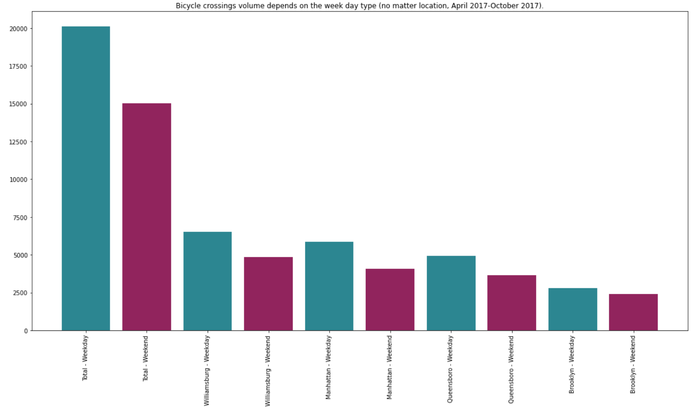
NYC East River Bicycle Crossings
New Yorkers more frequently perform biycle bridge-crossing on weekdays than weekends
Date range: April 2017 – October 2017

Slide 8
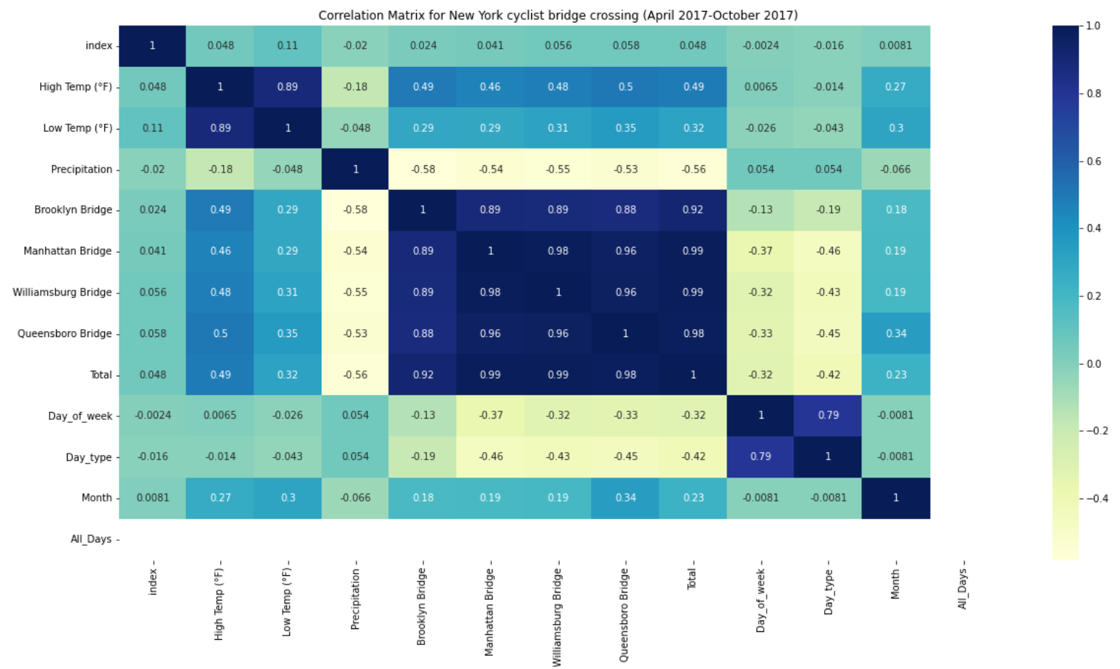
NYC East River Bicycle Crossings
overall bicycle crossings are correlated with locations, weekdays, high temp and precipitation
Date range: April 2017 – October 2017

Slide 9
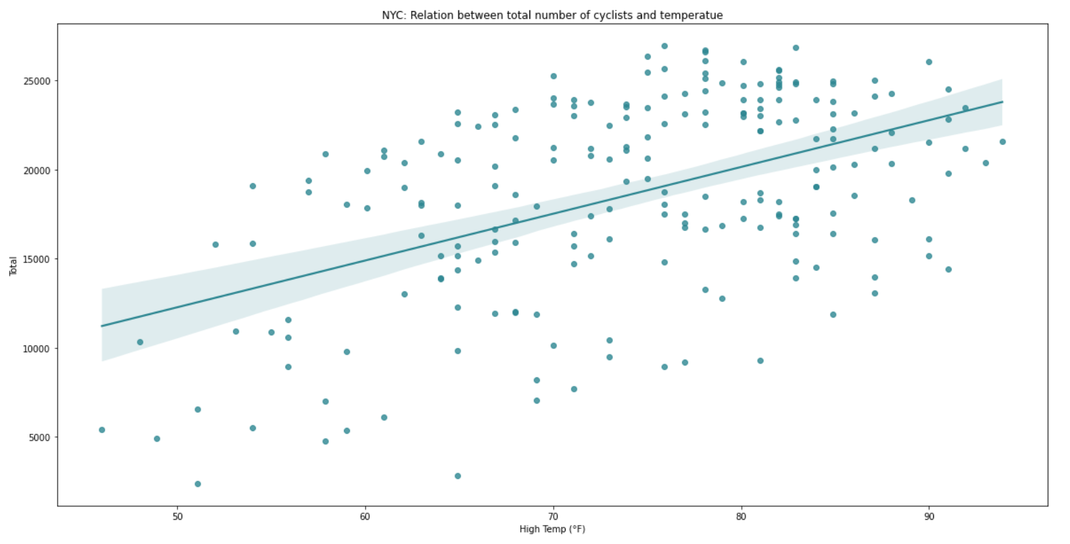
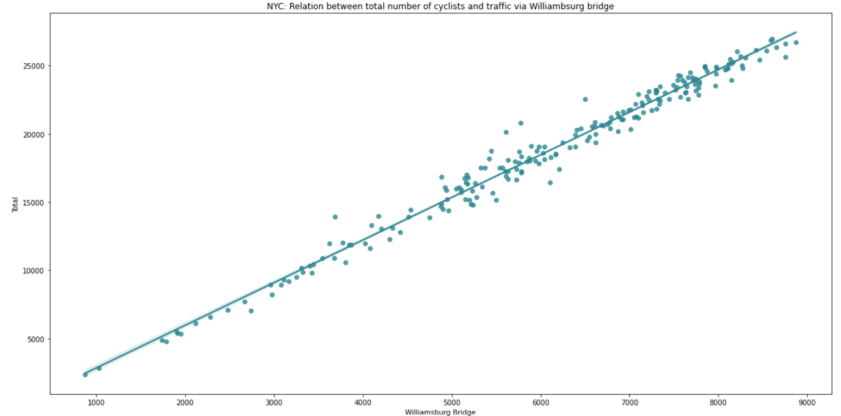
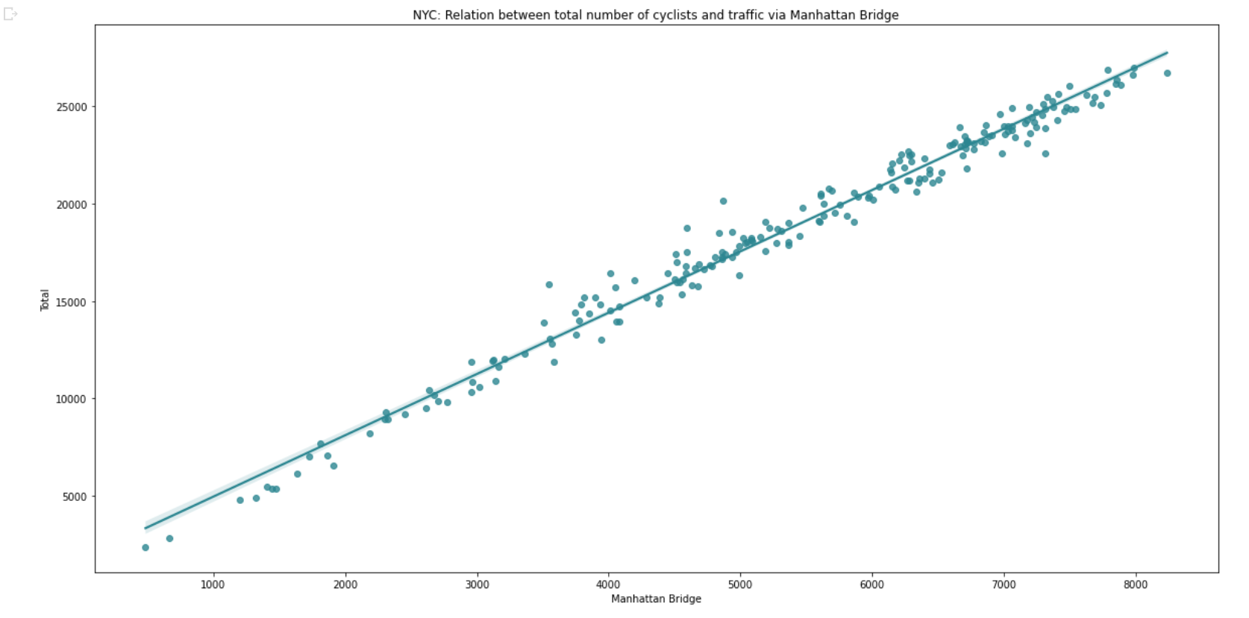
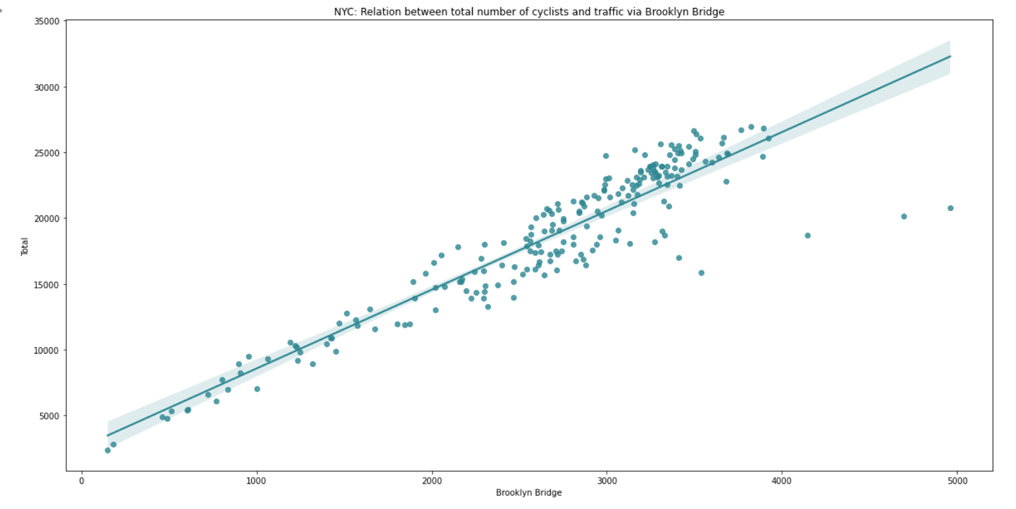
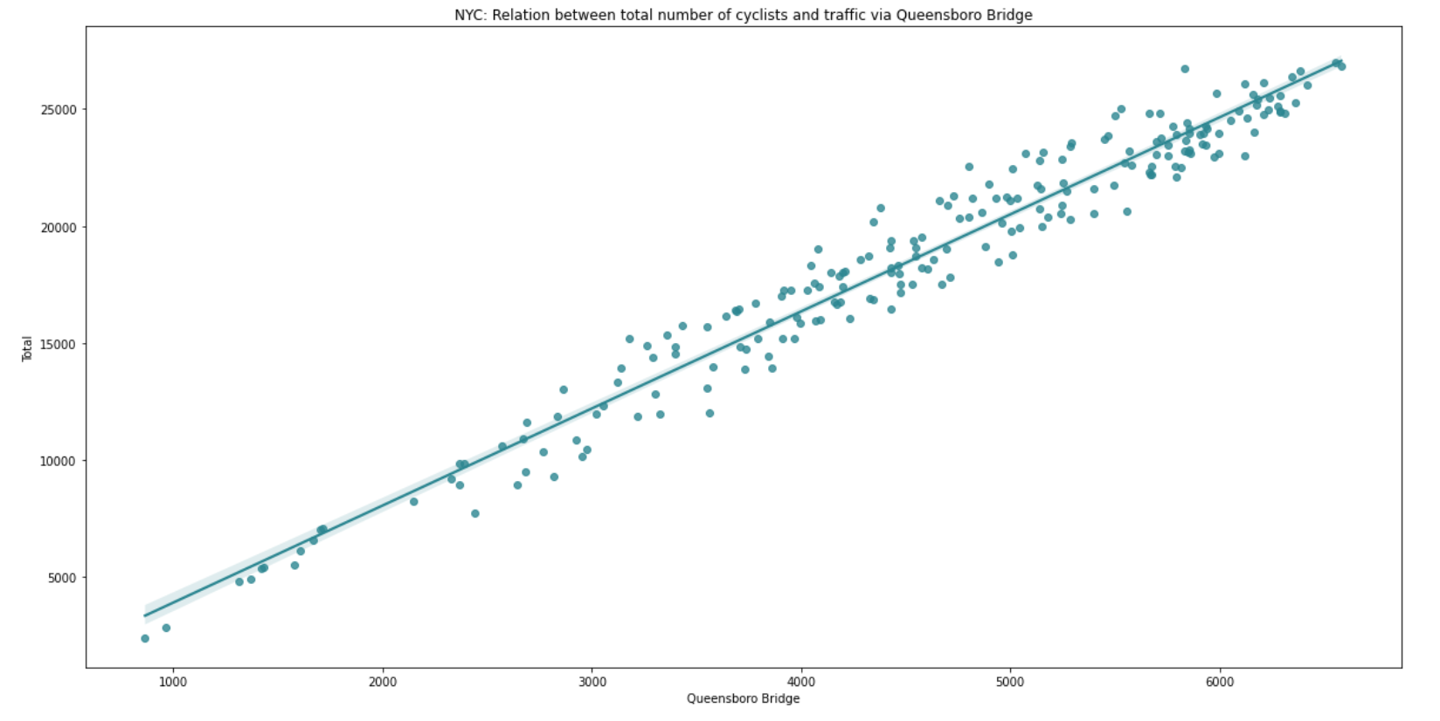
NYC East River Bicycle Crossings
most relations have a liniear character
Linear Regression model can be a good predictive model
Alternative approaches: polynomial regression, decision tree
Date range: April 2017 – October 2017

Slide 10
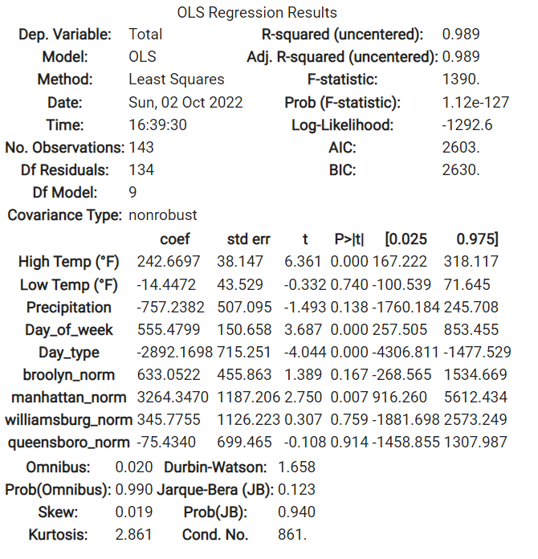
NYC East River Bicycle Crossings
linear regression is a best fit to predict the total bicycle crossings volume
Bicycle crossings volume depends on:
traffic volume on the Manhattan Bridge,
type of the day: weekend or weekday,
precipitation.
How well does model predict the bike crossings?
R2 Score: 1.0
MAE: 4.12
MAPE: 2.7%
RMSE: 5.08
Date range: April 2017 – October 2017

Slide 11

Isn’t that too easy for that model to predict having bridge locations included?

Slide 12
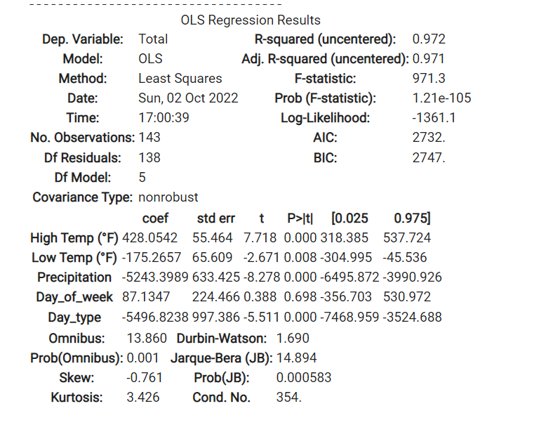
NYC East River Bicycle Crossings
linear regression – excl. bridge locations
By excluding bridge locations, model brought much worse:
accuracy of predictions,
extent of explanation,
fit to the nominal data.
How well does model predict the bike crossings?
R2 Score: 0.51
MAE: 2773
MAPE: 0,21%
RMSE: 3538
Date range: April 2017 – October 2017

Slide 13

NYC East River Bicycle Crossings
alternative models used
polynomial regression and decision tree
They were not a fit as most of independent variables are linearly related with total bicycle crossings volume.

Slide 14

NYC East River Bicycle Crossings
what could be done better?
Include more data - include at least entire annual data to capture seasonal trends (watch out for anomalies of 2020).
Register additional dimensions like hour of the day to capture cyclists’ commute patterns.

